Slide 1
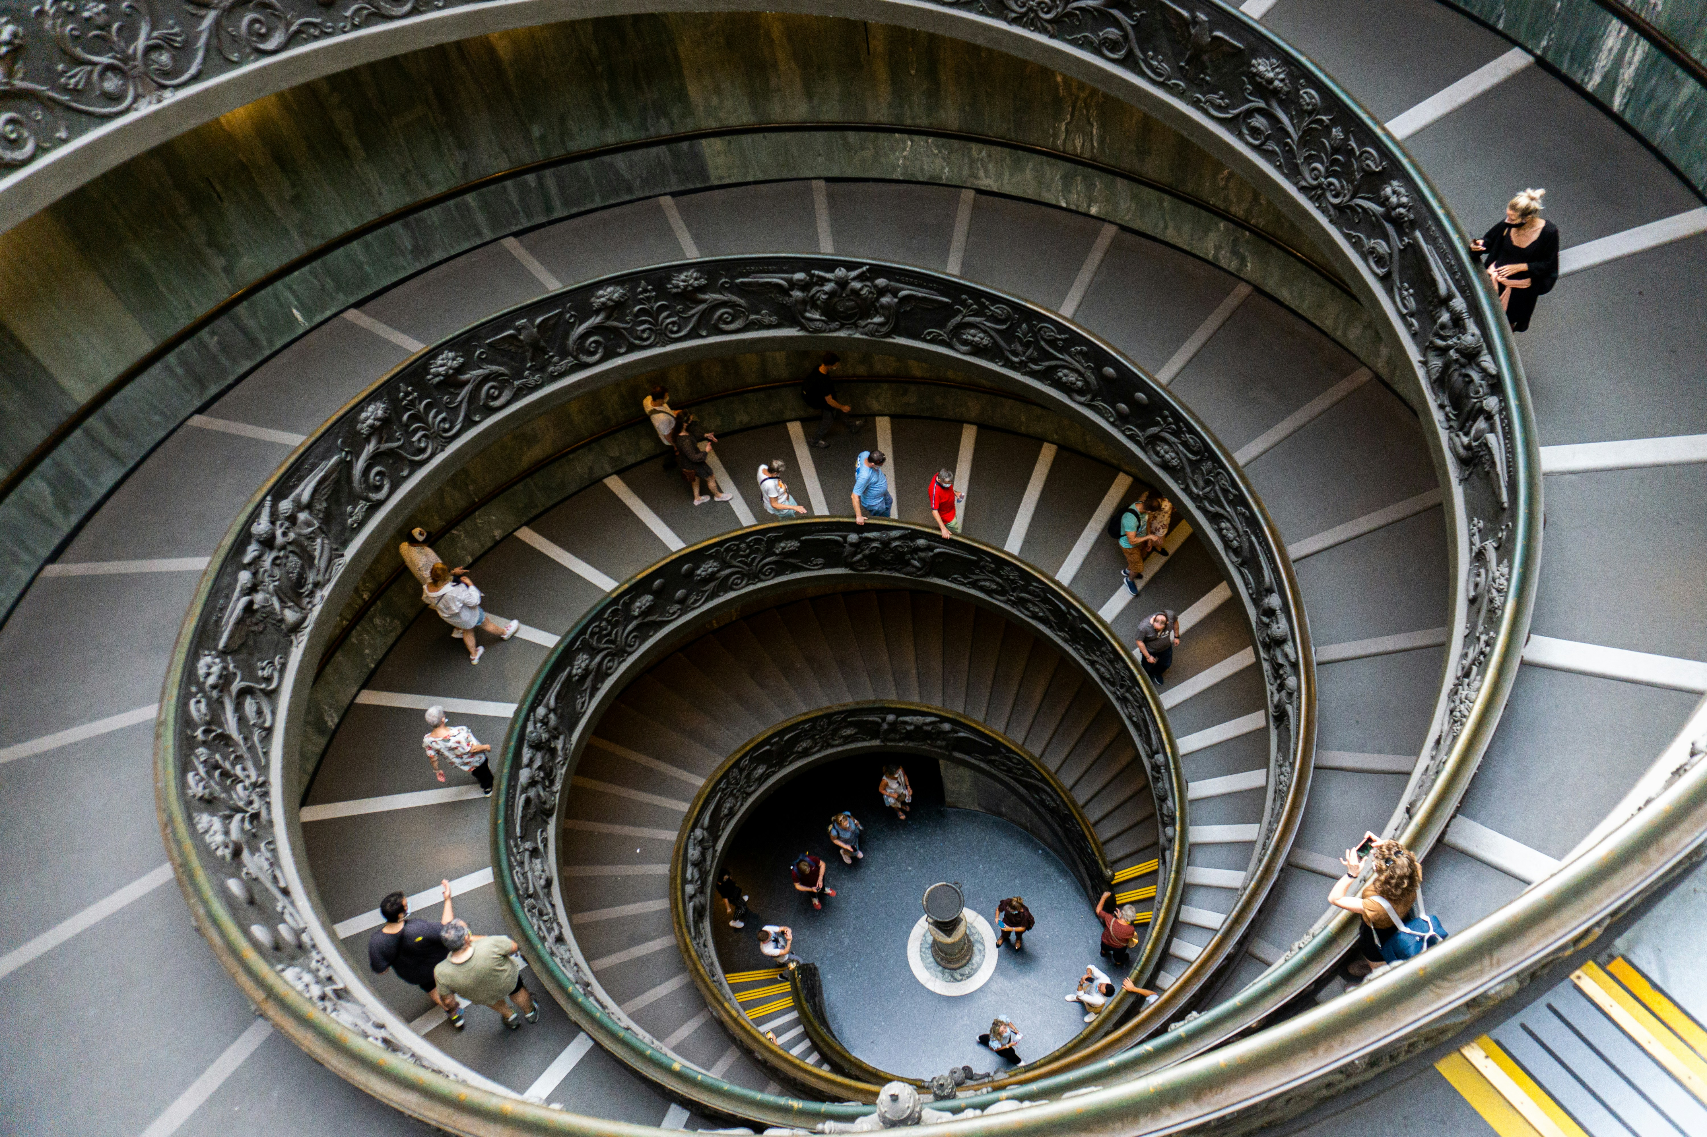
Metrocar Project
Diana Alejandra Terraza

Slide 2

What is Metrocar?
Metrocar's business model is based on a platform that connects riders with drivers through a mobile application.
Metrocar acts as an intermediary between riders and drivers, providing a user-friendly platform to connect them and facilitate the ride-hailing process.

Slide 3

Objectives of this project
Identify what steps of the funnel should we research and improve
Deduct where to focus our marketing budget and the insights can we make based on the platform.
Identify what age groups perform best at each stage and which age group(s) contain our target customers.
Based on data, provide marketing “surge pricing” and strategies to do it.
Identify what part of our funnel has the lowest conversion rate and what can we do to improve this part of the funnel.

Slide 4

Metrocar Structure
Metrocar typically includes the following stages:
App Download: A user downloads the Metrocar app from the App Store or Google Play Store.
Signup: The user creates an account in the Metrocar app, including their name, email, phone number, and payment information.
Request Ride: The user opens the app and requests a ride by entering their pickup location, destination, and ride capacity (2 to 6 riders).

Slide 5
4. Driver Acceptance: A nearby driver receives the ride request and accepts the ride.
5.Ride: The driver arrives at the pickup location, and the user gets in the car and rides to their destination.
6.Payment: After the ride, the user is charged automatically through the app, and a receipt is sent to their email.
7. Review: The user is prompted to rate their driver and leave a review of their ride experience.

Slide 6
FOR OUR ANALYSIS
Steps and Names
0 Download
1 Signup
2 Ride Request
3 Ride Accepted

Slide 7
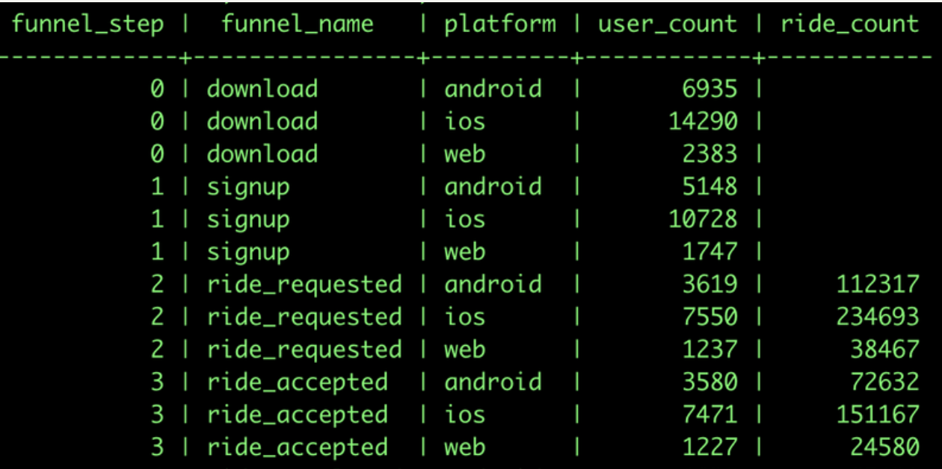
Previous Aggregate Result

Slide 8
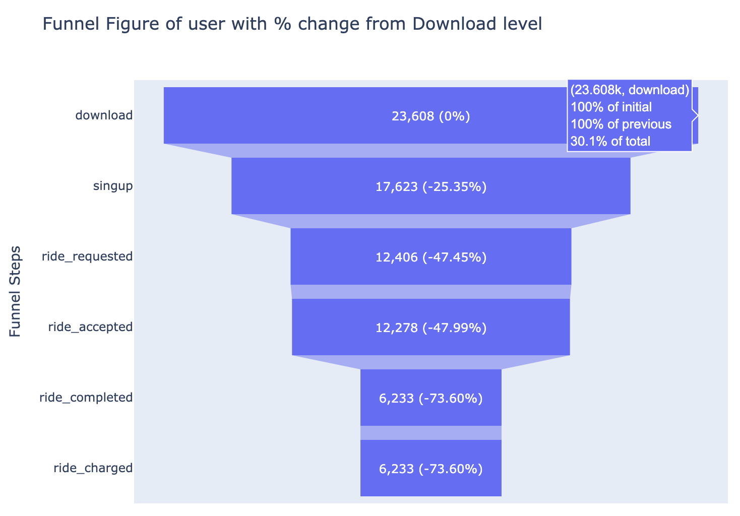
Funnel Figure based on Downloads (percentage)

Slide 9
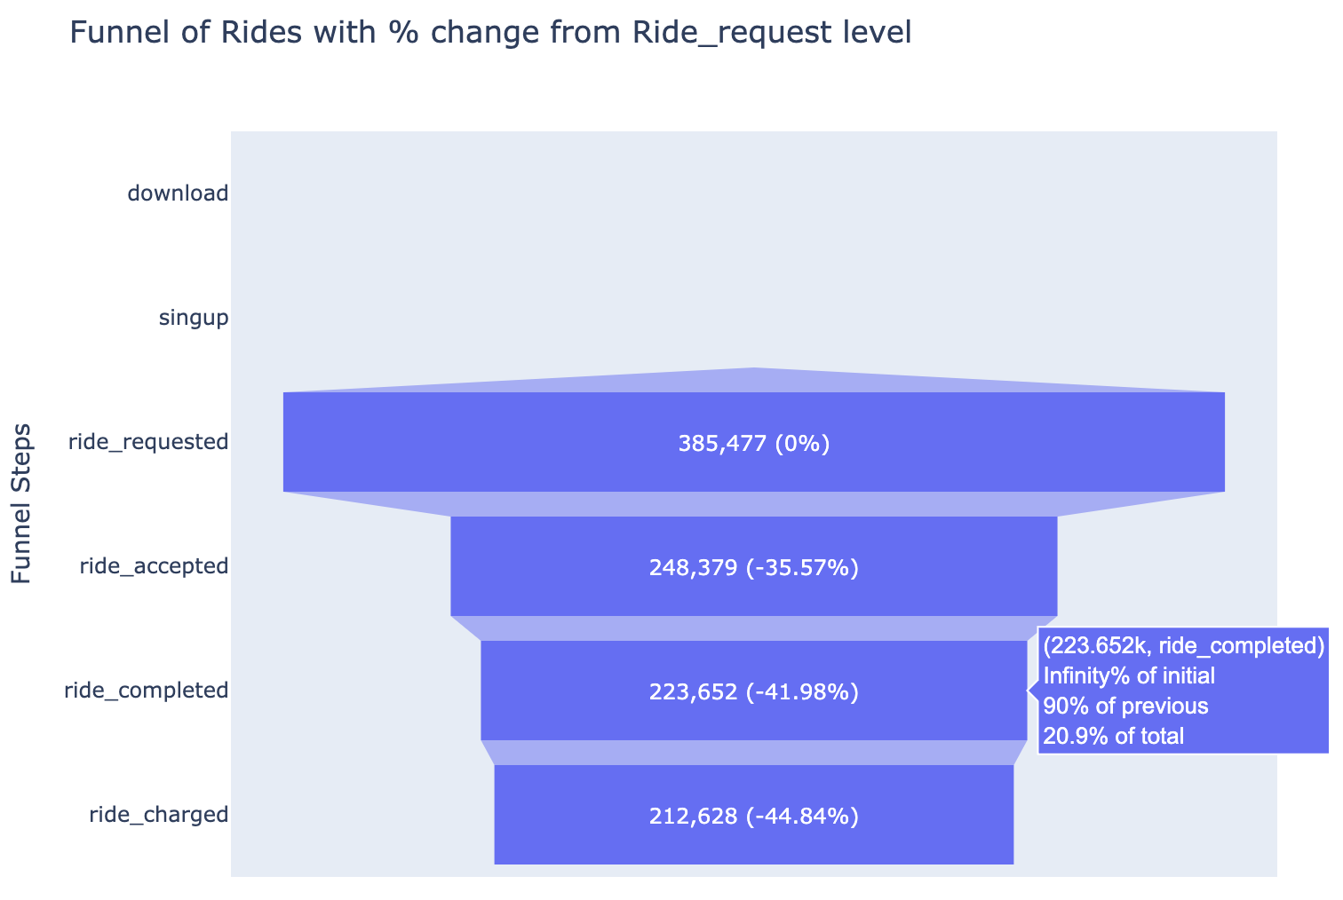
Funnel of Rides with percent of change based on Ride Request level

Slide 10
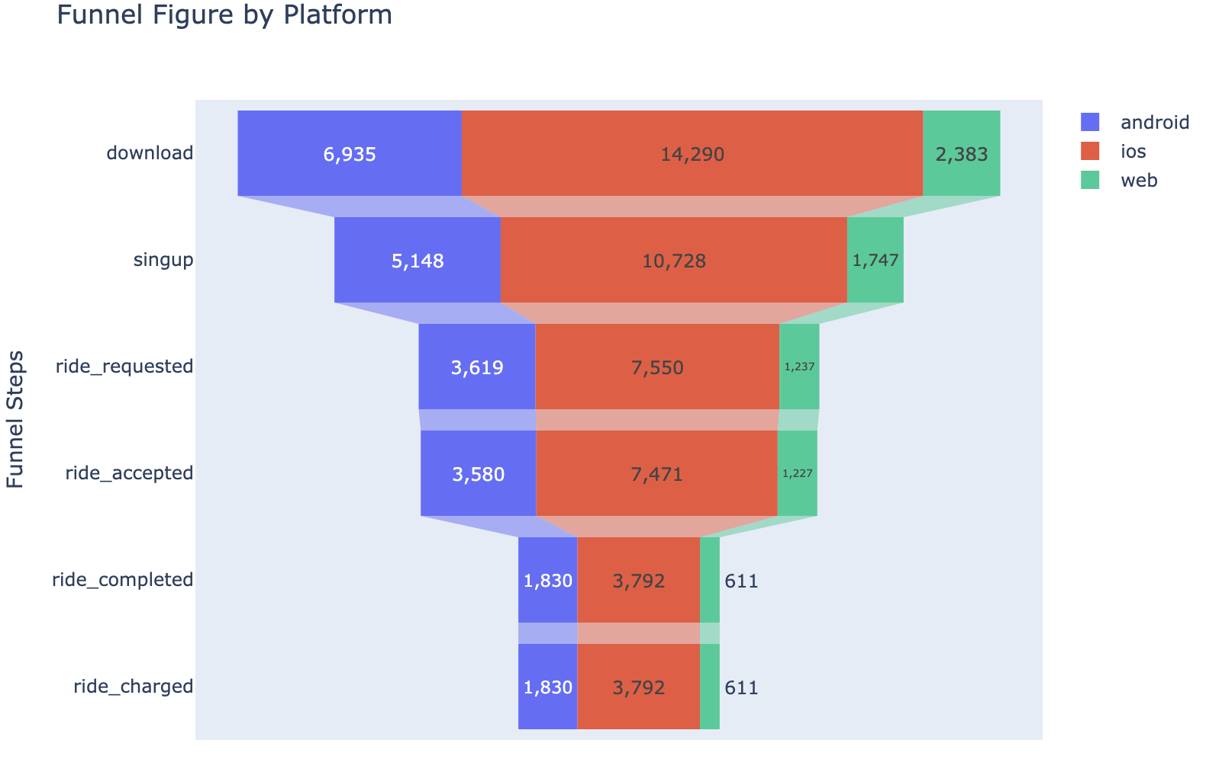
Funnel based on Platform

Slide 11
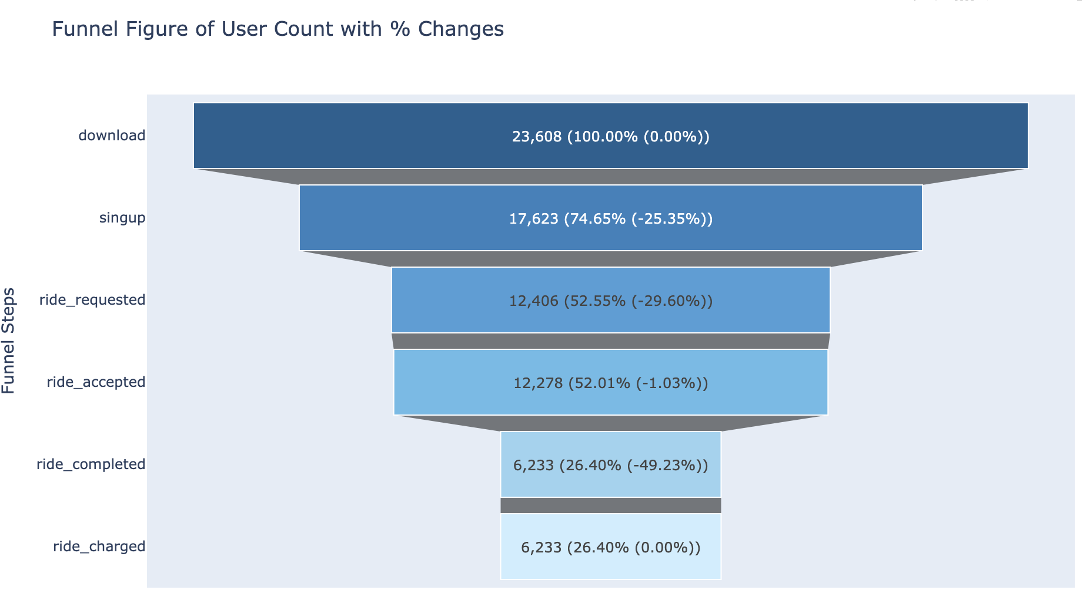
Funnel Figure of User Count with Percent Changes

Slide 12
Drop-off Table
Since users download the application and sign up, there is a 25.4% drop.
Of the registered users, few require a trip, which corresponds to a 29.6% drop
Finally, there is the step that presents the highest abandonment between accepting the ride and completing it with a 49.2% drop-off.
Funnel Step | From Funnel Name | To Funnel Name | User Count Drop | Drop-off Percentage
0 | Download | Signup | 5985 | 25.4%
1 | Signup | Ride_request | 5217 | 29.6%
2 | Ride_request | Ride_accepted | 128 | 1.0%
3 | Ride_accepted | Ride_completed | 6045 | 49.2%
4 | Ride_completed | Ride_charged | 0 | 0.0%

Slide 13
Possible causes of drop-off
Difficulties in the registration process, it can be too long and tedious
Users are skeptical about sharing their personal information
The application is not user-friendly
Delays in assigning drivers or not enough drivers available during the day even in rush hours.
Long wait times or unexpected price increases
Technical problems with the app requesting a ride.

Slide 14
Suggested Strategy for Users
Discounts or Credits for Frequent Riders: Offer discounted fares or ride credits for users who frequently book rides or use the app during off-peak hours to smooth out demand during non-peak periods.
Referral Programs: Incentivize riders to refer new users to the app. Both the referrer and the new user could receive ride credits or discounts, helping to expand the user base and reduce the gap between demand and supply.

Slide 15
Loyalty Programs: Implement a tiered loyalty program where frequent riders earn rewards, such as exclusive discounts or priority access to drivers, based on the number of rides they complete in a given period.
First-time Rider Discounts: Offer new users significant discounts on their first few rides to encourage them to try the app and get comfortable using it, which could lead to higher engagement over time.

Slide 16
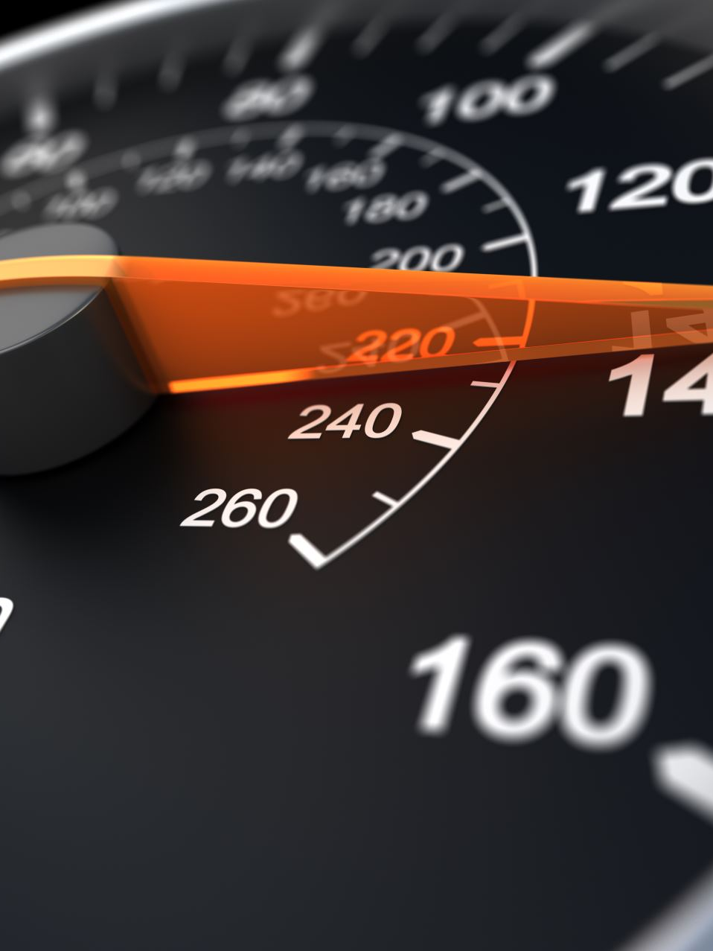
Suggested Strategy for Drivers
Bonuses for Ride Acceptance and Completion: Drivers can be offered bonuses for accepting and completing a set number of rides within a specific timeframe. For example, completing 10 rides in a day could result in an additional bonus.
Surge Pricing and Peak Hours Incentives: Offering higher fares during peak hours or in areas with high demand can encourage drivers to accept more rides when needed, minimizing gaps in coverage.
Rewards Programs: Implement a rewards system where drivers accumulate points for each ride completed. These points can later be exchanged for cash bonuses, fuel discounts, or other rewards.

Slide 17
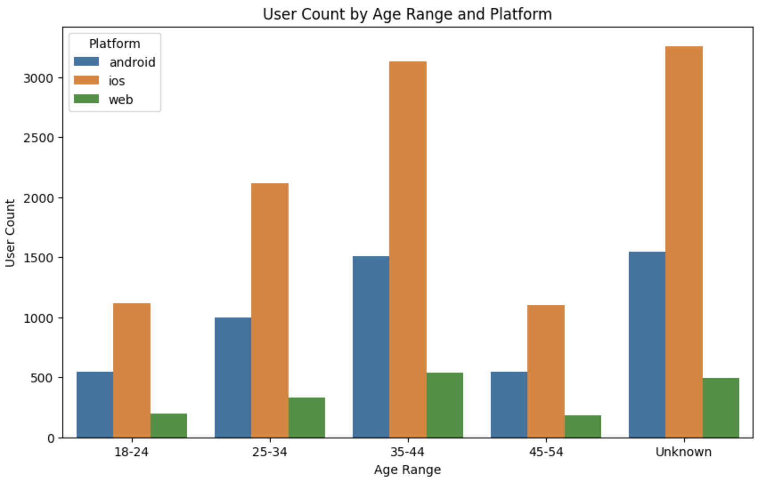
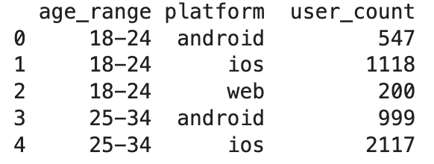
User Count by Age Range and Platform

Slide 18
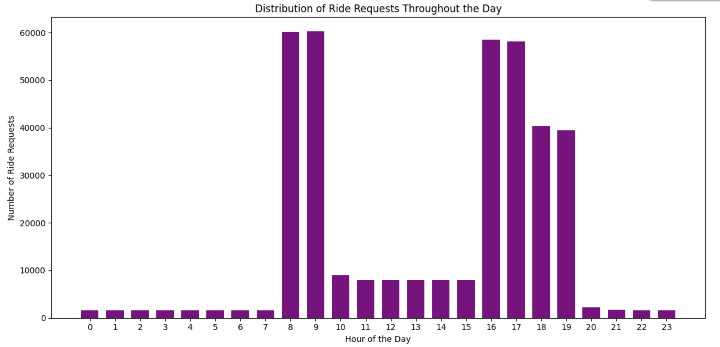
Distribution of Ride Request Throughout the Day
The peak of high demand during the day is between 8 and 9 in the morning and in the afternoon hours from 4 in the afternoon to 7, which suggests surging-price strategy in this time.

Slide 19

Suggested Strategy
Motivate users to use the app ”Metrocar" during peak hours with a higher price (surging-price), obtaining a percentage discount on their next ride that does not correspond to peak hours.

Slide 20
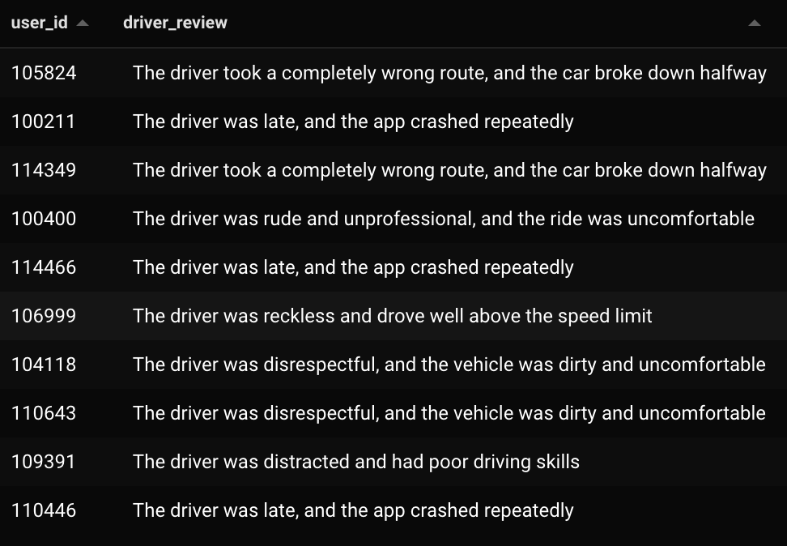
TOP 10 Negative Reviews based on the Driver

Slide 21
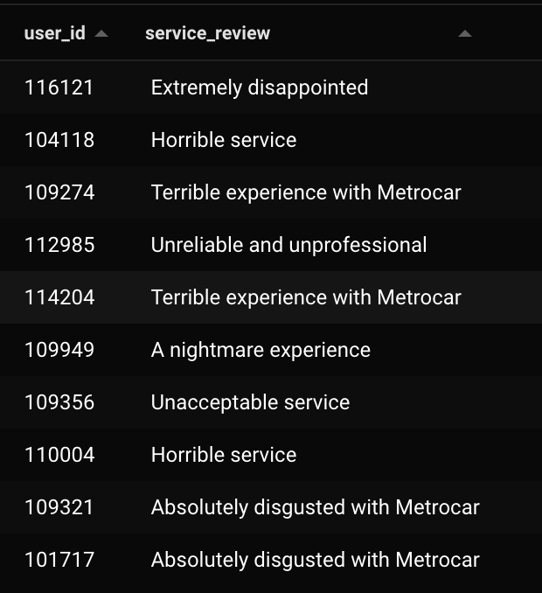
Top 10 Negative Reviews based on the Service

Slide 22
Suggested Strategy
Encourage the writing of multiple choice reviews, or predetermined messages with which the user feels identified and always provides a review when using the service for the purposes of quality improvement.

Slide 23

Conclusions and recommendations
The part of our funnel with the lowest conversion rate corresponds from the step "Ride Request" to the "Ride complete", also based on user reviews. For improve this you could:
1. Make the process of booking a ride as easy and seamless as possible.
2. Minimize the time users wait for a ride after booking.
3. Develop fair and transparent pricing mechanisms for both users and drivers even during rush hour.

Slide 24

Conclusions and recommendations
4. Retain a high number of drivers and riders on the platform to have more options to find a driver and not cancelled the service.
5. Improve the passenger experience by ensuring safety, convenience, and comfort during transit.
6. Ensure that users enter all required fields, including age, and provide security for data processing.

